Slide 1
The State of Techniques for Solving Large Imperfect-Information Games
Tuomas Sandholm

Slide 2
Incomplete-information game tree
0.2
0.3
0.5
Information set
0.5
0.5
Strategy,
beliefs

Slide 3
Tackling such games
Domain-independent techniques
Techniques for complete-info games don’t apply
Challenges
  Unknown state
  Uncertainty about what other agents and nature will do
  Interpreting signals and avoiding signaling too much
Notes:
(Speculation, counter-speculation, … ad infinitum -> Nash)

Slide 4
Most real-world games are like this
Negotiation
Multi-stage auctions (FCC ascending, combinatorial)
Sequential auctions of multiple items
Political campaigns (TV spending)
Military (allocating troops; spending on space vs ocean)
Next-generation (cyber)security (jamming [DeBruhl et al.]; OS)
Medical treatment [Sandholm 2012, AAAI-15]
…
Notes:
(e.g., China owns US reserves)
Has bluffs: Pas de Calais, Israel’s war with Lebanon, Qin’s army, forts
Combat
Currency attacks
International (over-)fishing
In cybersecurity, active security: identify opponent’s objectives and defend based on that.
From our MURI proposal: Attacks against memory vulnerabilities depend crucially on the memory layout of the program
being targeted. On the other hand, legitimate programs are agnostic to details of memory layout
because of mechanisms such as dynamic linking. Our adaptive defense strategies will make use of
artificial diversity mechanisms such as Address-Space Layout Randomization, or ASLR—a mitigation
technique based on this observation. ASLR changes the layout of memory segments in
a process’ address space, making it difficult for the attacker to calculate the addresses he needs
to mount his attack. ASLR is implemented in most modern operating systems. ASLR introduces
artificial diversity to running systems, making them more resistant to attack [52]. The deployed versions
of ASLR have low runtime overhead but are vulnerable to attack by determined adversaries,
for example after searching the space of possible randomizations by brute force (see Shacham et
al. [125]). Researchers have demonstrated the feasibility of randomizing substantially more features
of a running system [15], but their proposals have not yet seen adoption.”

Slide 5

Poker
Recognized challenge problem in AI since 1992 [Billings, Schaeffer, …]
  Hidden information (other players’ cards)
  Uncertainty about future events
  Deceptive strategies needed in a good player
  Very large game trees
NBC National Heads-Up Poker Championship 2013
Notes:
2-player is highly complex & difficult to play well.
Mano a mano
No others to muddle up the game.
(Luck plays a smaller role.)
(Picture is a Heads-Up competition televised by NBC.)

Slide 6
Our approach [Gilpin & Sandholm EC-06, J. of the ACM 2007…]
Now used basically by all competitive Texas Hold’em programs
Original game
Abstracted game
Automated abstraction
10¹⁶¹
Custom
equilibrium-finding
algorithm
Nash equilibrium
Reverse model
Nash equilibrium
Foreshadowed by Shi & Littman 01, Billings et al. IJCAI-03
Notes:
MENTION AS OUTLINE:
- Opponent exploitation
- Bots vs pros
- Learning from bots
(Reverse model is straightforward if only signals are abstracted, but an interesting problem if also actions are abstracted, as in No-Limit Texas Hold’em.)

Slide 7
Lossless abstraction
[Gilpin & Sandholm EC-06, J. of the ACM 2007]
Notes:
JACM reviewer: This is to incomplete-information games like what alpha-beta search is to complete-information games.

Slide 8
Information filters
Observation: We can make games smaller by filtering the information a player receives
Instead of observing a specific signal exactly, a player instead observes a filtered set of signals
  E.g. receiving signal {A♠,A♣,A♥,A♦} instead of A♥
Notes:
Information filters isolate signal history from action history

Slide 9
Signal tree
Each edge corresponds to the revelation of some signal by nature to at least one player
Our abstraction algorithm operates on it
  Doesn’t load full game into memory

Slide 10
Isomorphic relation
Captures the notion of strategic symmetry between nodes
Defined recursively:
  Two leaves in signal tree are isomorphic if for each action history in the game, the payoff vectors (one payoff per player) are the same
  Two internal nodes in signal tree are isomorphic if they are siblings and their children are isomorphic
    Challenge: permutations of children
    Solution: custom perfect matching algorithm between children of the two nodes such that only isomorphic children are matched
Notes:
(The orange part is determined using a custom perfect matching algorithm in a bipartite graph.)

Slide 11
Abstraction transformation
Merges two isomorphic nodes
Theorem. If a strategy profile is a Nash equilibrium in the abstracted (smaller) game, then its interpretation in the original game is a Nash equilibrium
Notes:
(Interpretation into the original game is straightforward.)

Slide 12
GameShrink algorithm
Bottom-up pass: Run DP to mark isomorphic pairs of nodes in signal tree
Top-down pass: Starting from top of signal tree, perform the transformation where applicable
Theorem. Conducts all these transformations
  Õ(n²), where n is #nodes in signal tree
  Usually highly sublinear in game tree size

Slide 13

Solved Rhode Island Hold’em poker
AI challenge problem [Shi & Littman 01]
  3.1 billion nodes in game tree
Without abstraction, LP has 91,224,226 rows and columns => unsolvable
GameShrink for abstracting the “signal tree” ran in one second
After that, LP had 1,237,238 rows and columns (50,428,638 non-zeros)
Solved the LP
  CPLEX barrier method took 8 days & 25 GB RAM
Exact Nash equilibrium
Largest incomplete-info game solved
by then by over 4 orders of magnitude
Notes:
Most of the game was redundant.

Slide 14
Lossy abstraction

Slide 15
Texas Hold’em poker
2-player Limit has ~10¹⁴ info sets
2-player No-Limit has ~10¹⁶¹ info sets
Losslessly abstracted game too big to solve => abstract more => lossy
Nature deals 2 cards to each player
Round of betting
Nature deals 3 shared cards
Round of betting
Nature deals 1 shared card
Round of betting
Nature deals 1 shared card
Round of betting
Notes:
Most popular poker variant.

Slide 16
Clustering + integer programming for abstraction
GameShrink can be made to abstract more => lossy
  Greedy => lopsided abstractions
Better approach: Abstraction via clustering + IP
[Gilpin & Sandholm AAMAS-07]
Notes:
Round by round starting from round 1
(Operates in signal tree of one player’s signals & common signals)

Slide 17
Potential-aware abstraction
All prior abstraction algorithms had probability of winning (assuming no more betting) as the similarity metric
  Doesn’t capture potential
Potential not only positive or negative, but “multidimensional”
We developed an abstraction algorithm that captures potential …
[Gilpin, Sandholm & Sørensen AAAI-07, Gilpin & Sandholm AAAI-08]
Notes:
Hands like flush draws where although the probability of winning is small, the payoff could be high

Slide 18
Bottom-up pass to determine abstraction for round 1
Round r-1
.3
.2
0
.5
Round r
In the last round, there is no more potential
=> use probability of winning as similarity metric
Notes:
probability of winning (e.g., assuming no more betting)
(Clustering, e.g., using L₁ norm
Predetermined number of clusters, based on size of abstraction we want)

Slide 19
Important ideas for practical card abstraction 2007-13
Integer programming [Gilpin & Sandholm AAMAS-07]
Potential-aware [Gilpin, Sandholm & Sørensen AAAI-07, Gilpin & Sandholm AAAI-08]
Imperfect recall [Waugh et al. SARA-09, Johanson et al. AAMAS-13]
Notes:
DAG
(Waugh, Zinkevich, Johanson, Kan, Schnizlein & Bowling)

Slide 20
Potential-Aware Imperfect-Recall Abstraction with Earth Mover's Distance
[Ganzfried & Sandholm AAAI-14]

Slide 21
Expected Hand Strength (EHS)
Early poker abstraction approaches used EHS (or EHS exponentiated to some power) to cluster hands [e.g., Billings et al. IJCAI-03, Gilpin & Sandholm AAAI-06, Zinkevich et al. NIPS-07, Waugh et al. SARA-09]
But…
Notes:
EHS (aka equity) is the probability of winning (plus ½ x probability of tying)
against a uniform random draw of private cards for the opponent,
assuming a uniform random rollout of the remaining public cards
4s4h and TsJs have very similar EHS (0.575 and 0.570), but 44 frequently has EHS in [0.4,0.6] and rarely in [0.7,0.9], while the reverse is true for TsJs
For example, with pocket aces in Texas Hold’em:
It will win 84.93% of the time and tie 0.27% of the time against a random hand with a random rollout of public cards
So EHS = 0.8493 + ½ * 0.27 = 0.852
Similarly, pocket kings has EHS 0.824
Since these two values are similar, it is likely that they would be grouped together by a clustering algorithm

Slide 22
Distribution-aware abstraction
Takes into account the full distribution of hand strength. Uses earth-mover’s distance (EMD) as distance metric between histograms
  Prior best approach used distribution-aware abstraction with imperfect recall (for flop and turn rounds) [Johanson et al. AAMAS-13]
Notes:
EMD: “minimum cost of turning one pile into the other, where cost is amount of dirt moved times the distance by which it is moved”
EMD can be computed in linear time for 1D setting, but more challenging in higher dimensions
Histograms were over equities after all public cards are dealt (assuming uniform random hand for opponent)

Slide 23
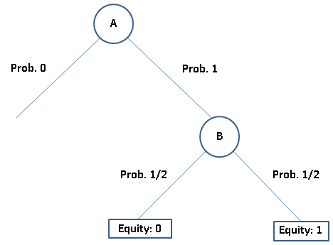
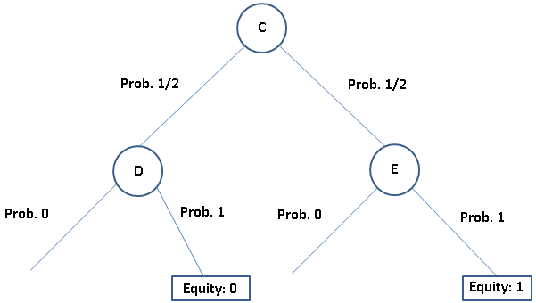
Potential-aware abstraction
Hands can have very similar distributions over strength at the end, but realize the equity at different ways/rates
Potential-aware abstraction [Gilpin, S., Soerensen AAAI-07] considers all future rounds, not just final round
In distribution-aware abstraction, histograms are over cardinal equities
In potential-aware abstraction, histograms are over non-ordinal next-round states => compute EMD in higher dim.
Private signal x₁
Private signal x₂
x₁ and x₂ have the same histogram
assuming game proceeds to the end:
Histogram for private signal x₂ at round 1
over non-ordinal information states at round 2:
Notes:
Distances between histogram components (e.g., d(B,D)) are called ground distances.

Slide 24
Potential-aware abstraction
[Gilpin, Sandholm & Sørensen AAAI-07]
Round r-1
.3
.2
0
.5
Round r
In the last round, there is no more potential
=> cluster using, e.g., probability of winning as similarity metric
Notes:
probability of winning (e.g., assuming no more betting)
(Clustering, e.g., using L₁ norm
Predetermined number of clusters, based on size of abstraction we want)

Slide 25
Leading practical abstraction algorithm:
Potential-aware imperfect-recall abstraction with earth-mover’s distance
[Ganzfried & Sandholm AAAI-14]
Bottom-up pass of the tree, clustering using histograms over next-round clusters
  EMD (earth mover’s distance) is now in multi-dimensional space
    Ground distance assumed to be the EMD between the corresponding next-round cluster means
Notes:
No need to perform multiple bottom up passes like in potential-aware abstraction before, due to imperfect recall.
No need for IP, due to imperfect recall.
Using our algorithm to compute the abstraction (for the flop round), we beat best prior abstraction algorithm

Slide 26

Techniques used to develop Tartanian7 and Baby Tartanian 8, programs that won the heads-up no-limit Texas Hold’em ACPC-14 and -16, respectively
[Brown, Ganzfried, Sandholm AAMAS-15; Brown & Sandholm 2016]
Enables massive distribution or leveraging ccNUMA
Abstraction:
  Top of game abstracted with any algorithm
  Rest of game split into equal-sized disjoint pieces based on public signals
    This (5-card) abstraction determined based on transitions to a base abstraction
  At each later stage, abstraction done within each piece separately
Equilibrium finding (see also [Jackson, 2013; Johanson, 2007])
  “Head” blade handles top in each iteration of External-Sampling MCCFR
  Whenever the rest is reached, sample (a flop) from each public cluster
  Continue the iteration on a separate blade for each public cluster. Return results to head node
  Details:
    Must weigh each cluster by probability it would’ve been sampled randomly
    Can sample multiple flops from a cluster to reduce communication overhead

Slide 27
Action abstraction
Typically done manually
Prior action abstraction algorithms for extensive games (even for just poker) have had no guarantees on solution quality
[Hawkin et al. AAAI-11, 12]
For stochastic games there is an action abstraction algorithm with bounds (based on discrete optimization)
[Sandholm & Singh EC-12]
Theory of Kroer & Sandholm [EC-14] also applies
First algorithm for parameter optimization for one player (in 2-player 0-sum games) [Brown & Sandholm AAAI-14]
  We use it for action size abstraction
  Warm starting regret matching / CFR via theoretically correct regret transfer
Simultaneous abstraction and equilibrium finding [Brown & Sandholm IJCAI-15]

Slide 28
Lossy Game Abstraction with Bounds

Slide 29
First lossy game abstraction algorithms with bounds
Proceed level by level from end of game
  Optimizing all levels simultaneously would be nonlinear
  Proposition. Both algorithms satisfy given bound on regret
Within level:
  Greedy polytime algorithm; does action or state abstraction first
  Integer program
    Does action and state abstraction simultaneously
    Apportions allowed total error within level optimally
      between action and state abstraction, and
      between reward and transition probability error
  Proposition. Abstraction is NP-complete
One of the first action abstraction algorithms
  Totally different than [Hawkin et al. AAAI-11, 12], which doesn’t have bounds
Notes:
Even with just action abstraction and just one level, (even with 2 agents), finding the abstraction with the smallest number of actions that respects a given regret bound is NP-complete.

Slide 30
Lossy game abstraction with bounds
Tricky due to abstraction pathology [Waugh et al. AAMAS-09]
Prior lossy abstraction algorithms had no bounds
  First exception was for stochastic games only [S. & Singh EC-12]
We do this for general extensive-form games
  Many new techniques required
  Abstraction performed in game tree (doesn’t assume game of ordered signals)
  Mathematical framework
  Algorithms, complexity results, impossibility for level-by-level approaches
  For both action and state abstraction
  More general abstraction operator
Notes:
(Explain relationship to abstraction pathology.)

Slide 31
Lossy game abstraction with bounds
Tricky due to abstraction pathology [Waugh et al. AAMAS-09]
Prior lossy abstraction algorithms had no bounds
  First exception was for stochastic games only [S. & Singh EC-12]
We do this for general extensive-form games
[Kroer & S. EC-14]
  Many new techniques required
  For both action and state abstraction
  More general abstraction operations by also allowing one-to-many mapping of nodes
Notes:
(Explain relationship to abstraction pathology.)
Abstraction performed in game tree (doesn’t assume game of ordered signals)

Slide 32



Definitions – abstraction
Original nodes map to abstract nodes
  Several real nodes can map to the same abstract node
  Node abstraction function
Must respect information set structure
  Information set abstraction function
  Action abstraction function
The functions are surjective (onto) in prior work and here (we relax later)
Abstraction usually achieved through merging branches
L
R
L/R
l
r
l
r
l
r
10
0
0
10
10
0

Slide 33
Strategy mapping
Strategy is computed in the abstract game, and must be mapped to the real game
Each real information set maps to some abstract information set
Probability on abstract action divided among real actions

Slide 34
Goal of our and prior work
Design abstraction such that:
  Size of abstract game is minimized
  Strategies computed in abstraction map to valid strategies in the real game
  Nash equilibria in the abstract game map to approximate Nash equilibria in the real game

Slide 35
Introducing a Theoretical framework and results

Slide 36


Strategy mapping
Lifted strategy:
  Requires that the sum of probabilities over a set of actions that map to the same abstract action is equal to the probability on the abstract action
Undivided lifted strategy:
  Lifted strategy where conditional probability of reaching an abstract node is equal to conditional probability of reaching any of the nodes mapping to it, when disregarding nature

Slide 37

Counterfactual value of information set
“agent i’s expected utility of information set I, assuming that all players follow strategy profile σ, except I plays to reach I”
Proof is performed by induction over information sets

Slide 38

Utility error
Utility error of a node s:
  Leaf nodes: absolute difference to abstract node
  Player nodes: maximum error of children
  Nature node: weighted error of children
  Formally:

Slide 39


Nature error
Nature distribution error of a player node s:
Nature distribution error of a nature node s:

Slide 40
Bounding abstraction quality
Main theorem:
where ε=max _{i∈Players} ε_{i}
Nature distribution
error at height j
Set of heights
for player i
Set of heights
for nature
Reward error
Nature distribution
error at height j
Maximum utility
in abstract game
Notes:
We define the reward error recursively:
at leaf nodes to be the maximum difference between values of the real leaf and the abstract leaves that it maps to,
at player nodes to be the maximum error of the child nodes, and
at nature nodes to be the weighted sum.
(The reward error for Player i of an information set I is the maximum error over the nodes in I, and the total
reward error is the maximum of this quantity over all information sets.)

Slide 41
Proof approach – two components
Lifted strategy does not lose much utility compared to strategy in the abstract game
  Doesn’t require reasoning about best responses
  Relatively simple to prove by induction on nodes, using error definitions
Best response doesn’t improve utility much over strategy in the abstract game
  Best responses derived on a per-information-set basis
  Requires more sophisticated techniques…

Slide 42
Best response doesn’t improve utility much over strategy in the abstract game
Performed on a single agent basis (strategies of other agents kept constant)
Induction over information sets
  Perfect recall ensures descendants contained in subtrees at set
Conditional distribution of nodes might be different
  Perfect recall
    Ensures player can’t change distribution
  Undivided lifted strategy
    Ensures that other players can’t change it
  Nature error
    Parameterize difference by nature error
    Use worst case bound over nature error difference
Off the equilibrium path subtrees
  Show that they can’t accumulate much additional utility
  Self-trembling equilibrium
    Player optimally responds at information sets reachable if the player played to reach them
    “Optimally respond to mistakes committed by the player herself”
  Player could have played a strategy satisfying this property
    Bound loss in terms of such a strategy for the abstract game
    At on the path information sets, Nash equilibrium in abstract game must do equally well

Slide 43
Best response does not improve utility much over strategy in the abstract game
Performed on a single agent basis
  Strategies of other agents kept constant
Induction over information sets
  Perfect recall ensures descendants contained in subtrees at set
Conditional distribution of nodes might be different
Off the equilibrium path subtrees
  Show that they can’t accumulate much additional utility

Slide 44
Conditional distribution of nodes might be different
Perfect recall
  Ensures player can’t change distribution
Undivided lifted strategy
  Ensures that other players can’t change it
Nature error
  Parameterize difference by nature error
  Use worst case bound over nature error difference

Slide 45
Off the equilibrium path subtrees
Self-trembling equilibrium
  Player optimally responds at information sets reachable if the player played to reach them
  Optimally respond to mistakes committed by the player herself
Player could have played a strategy satisfying this property
  Bound loss in terms of such a strategy for the abstract game
  At on the path information sets, Nash equilibrium in abstract game must do equally well

Slide 46
Tightness of bounds
Utility error bound is tight
  We show a game where bound is tight for every Nash equilibrium in every abstraction when implemented as any undivided lifted strategy
Nature distribution error bound is tight up to a factor of 6
  We show a game where it holds for some Nash equilibrium in every abstraction when implemented as any lifted strategy

Slide 47
Supports new abstraction operation: “Multi-mapping”
Node mapping one-to-many or many-to-one
E.g.: Information sets {2A, 2C} and {2B, 2D} are equivalent from Player 2’s perspective
  2A and 2B both multi-map to {2A, 2B}
  2C and 2D both multi-map to {2C, 2D}
Smaller information sets map onto bigger information sets
One-to-many has stricter conditions on ancestor and descendant similarity
  Ancestors must share information set
  Descendants must share information set
Error notions require slight modifications, same results
Lossless
multimapping

Slide 48
Multi-mapping example
Information sets {2A, 2C} and {2B, 2D} are equivalent from Player 2’s perspective
  2A and 2B both multi-map to {2A, 2B}
  2C and 2D both multi-map to {2C, 2D}

Slide 49
Computing Abstractions

Slide 50
Hardness results
Determining whether two subtrees are “extensive-form game-tree isomorphic” is graph isomorphism complete
Computing the minimum-size abstraction given a bound is NP-complete
  Holds also for minimizing a bound given a maximum size
Doesn’t mean abstraction with bounds is undoable or not worth it computationally
Notes:
Q: Why is this relevant if the level-by-level abstraction is impossible anyway? And I thought “extensive-form game-tree isomorphism” was ill-defined?
A: That's a good question. One answer could be that it simply shows another facet of the hardness of abstraction: Even just determining if the tree shape is correct for merging two subgames is graph isomorphism complete. Also, since that applies even for two subgames, it shows hardness in a setting where the impossibility result doesn't even apply.
(I would probably take out the "Needed to reason about level-by-level" since I think it's an interesting hardness aspect in its own right, and that would avoid the confusion about whether it even matters due to the impossibility.)

Slide 51
Level-by-level abstraction impossibility
Example where level-by-level abstraction can’t find even lossless abstraction (all suit isomorphisms)
  Deck has 2 jacks and 2 kings
  Jack abstracted
  King abstracted for
  private cards
  Public kings lead to
  information gain

Slide 52
Impossibility: Level-by-level abstraction can’t find even lossless abstraction (all suit isomorphisms)
Signal tree:
J1
K1
J2
K2
Not shown
J2
K2
J1
K2
K1
J2
J1
K1
J2
K1
J2
J2
J2
J1
J1
J2
J1
J1
K2
K2
K1
K2
K2
J2
K1
K1
J2
1
δ
1
1
1
1
1
1
1
1
1
1
1
1
1
1
1
1
If δ=1, the whole game reduces to a single line, as nothing matters.
If δ≠1, green K1 and K2 are not eligible for merging due to yellow K1 and K2.
Notes:
Explanation of counter-example:
We are concerned with the question of whether the decision to merge K1 and K2 at the root is valid for maintaining a lossless abstraction. In this example, that choice depends on the value of delta, which is in a different branch at a different level.
If delta is 1 then every payoff is 1, so the game reduces to a single line.
If delta is NOT 1, then K1 and K2 cannot be losslessly abstracted at the root. The reason for this is that J1 and J2 branches would have to map onto each other in the K1 and K2 subtrees (marked with dark green), but these J1 and J2 subtrees in turn have public K1 and K2, which would then have to map onto each other for player 2. This causes a problem in the leftmost subtree, since the nodes mapped onto each other come from the two different information sets marked with red lines across leaf nodes. This would require the whole information sets to be merged, which is clearly not lossless, as the choice between public K1 or K2 matters in the leftmost subtree.
RELATIONSHIP TO GAMESHRINK (WHICH USES DP): The impossibility cannot arise in RI Hold’em, but can in general games of ordered signals. We don’t know how much the class of games of ordered signals would have to be restricted for the impossibility to go away and GameShrink to apply.

Slide 53
Integer programming model
IP model for whole game tree
Variables represent merging node pairs
Number of variables quadratic in leaf nodes
Number of constraints quadratic in leaf nodes and cubic in maximum number of information sets at a single level

Slide 54
Experiments on simple poker game
5 cards
  2 kings
  2 jacks
  1 queen
Limit hold’em
  2 players
  1 private card dealt to each
  1 public card dealt
  Betting after cards are dealt in each round
  2 raises per round

Slide 55
In this *experiment* we use signal tree-based abstraction
Tree representing nature actions that are independent of player actions
Actions available to players must be independent of these
Abstraction of signal tree leads to valid abstraction of full game tree

Slide 56
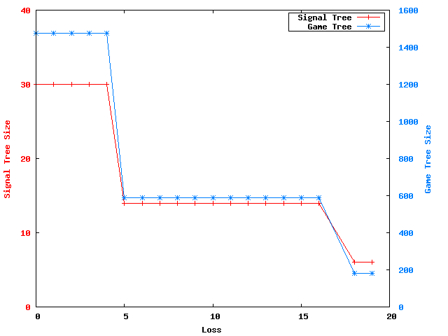
Experiments that minimize tree size

Slide 57
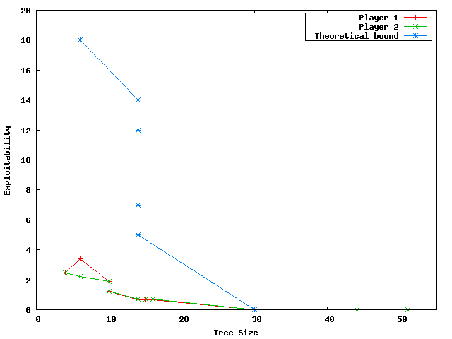
Experiments that minimize bound

Slide 58
Extension to imperfect recall
Merge information sets
Allows payoff error
Allows chance error
Going to imperfect-recall setting costs an error increase that is linear in game-tree height
Exponentially stronger bounds and broader class (abstraction can introduce nature error) than [Lanctot et al. ICML-12], which was also just for CFR
[Kroer and Sandholm IJCAI-15 workshop]
Notes:
No branch removal
But can be supported by removing branches to a perfect-recall abstraction first using our theory for that step
Sum of errors at levels where player is active
Similar to perfect-recall bound, for a single level

Slide 59
Algorithms
We show NP-hardness of minimizing bound
We show that abstraction with bound-minimization is equivalent to clustering
  In single-level abstraction problem
  Error function forms a metric space when abstracting observations of player actions
    Yields 2-approximation algorithm
  Introduce new clustering objective function for general case

Slide 60
Experiment
Die-roll poker
  Small poker variant that uses two private 4-sided die rolls to determine the hand of each player
Rolls are correlated: if player 1 rolls a 2, then player 2 is more likely to roll a 2, etc.
Perform abstraction on which die-rolls are treated the same
  Solved with integer program

Slide 61
Full-game regret
(in correlated die-roll poker, abstraction computed using IP)
Sum of players’ regrets
Sum of players’ regrets
Correlation
between
“cards” => coarser abstraction
CFR
CFR
Notes:
The abstraction was done at one level with IP to solve the clustering.
New idea (not shown): ex post bounds.

Slide 62
Role in modeling
All modeling is abstraction
These are the first results that tie game modeling choices to solution quality in the actual world!

Slide 63
Strategy-based abstraction
Abstraction
Equilibrium finding
Notes:
(Good abstraction as hard as equilibrium finding?)

Slide 64
Regret Transfer and Parameter Optimization with Application to Optimal Action Abstraction
Noam Brown and Tuomas Sandholm
AAAI-14

Slide 65
Optimal Parameter Selection
Action abstraction: action size selection
  (Optimizing together with probabilities would be quadratic)
Each abstraction has a Nash equilibrium value that isn’t known until we solve it.
We want to pick the optimal action abstraction (one with highest equilibrium value for us)

Slide 66
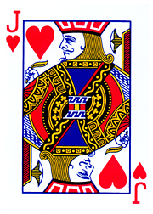
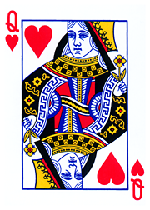
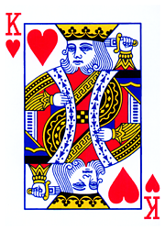




P1
Fold
Bet $θ$
$$0$$
P2
Fold
Call
$$1$$
$$±θ$$
Goal: Pick $θ$ so that Nash Equilibrium value is maximized for Player 1
Notes:
Suppose we have a set of games parameterized by \theta. We want to find the value of \theta corresponding to a game whose Nash equilibrium is maximal for Player 1.

Slide 67
Convergence to $ε$-Nash equilibrium
Notes:
(Speculation, counter-speculation, … ad infinitum -> Nash)

Slide 68
Convergence to $ε$-Nash equilibrium
Notes:
(Speculation, counter-speculation, … ad infinitum -> Nash)

Slide 69
Convergence to $ε$-Nash equilibrium
Notes:
(Speculation, counter-speculation, … ad infinitum -> Nash)

Slide 70
Convergence to $ε$-Nash equilibrium
Notes:
(Speculation, counter-speculation, … ad infinitum -> Nash)

Slide 71

Convergence to $ε$-Nash equilibrium
Scale Amount:$O\left(\frac{1}{{\left(1+δ\sqrt{T}\right)}^{2}}\right)$
Notes:
(Speculation, counter-speculation, … ad infinitum -> Nash)

Slide 72

Regret transfer
Key Idea: Store regret as a function of $θ$. When $θ$ changes, we can calculate regrets in the new game in $O(1)$.
Theorem 1: Suppose we replay $T$ iterations of regret matching in a new game with a different $θ$. We denote regret in this new game by $R′$. Consider any weight $w_{i}$ for agent $i$ such that
$$0≤w_{i}≤\frac{|I|\left|A_{i}\right|Δ_{i}^{2}T}{\sum_{I}{{(R_{T,i}^{c}(I))}^{2}}}$$
We can weigh the $T$ iterations by $w_{i}$ and then play according to CFR without any penalty to convergence.
This essentially gives us $w_{i}T$ free iterations each time $θ$ changes.
Notes:
If we store regret as a function of \theta. Then whenever \theta changes we can immediately update regret for that new game. However, we did not play according to CFR in this new game, so our convergence guarantees no longer hold.
Fortunately, we can still guarantee CFR converges at the same right by discounting the prior iterations. The amount we discount depends on how high the regret is in the new game. If regret in the new game is low (as it would be when the change to the game is small), then we can carry over a lot of what we learned previously.

Slide 73

Gradient descent with regret transfer
Step 1:Do $K_{1}$ iters of CFR
Epsilon Bars

Slide 74
Step 2:Estimate gradient
Epsilon Bars

Slide 75
Step 3:Move theta, transfer regret

Slide 76

Step 4: Do $K_{2}$ iters of CFR
Epsilon bars expand

Slide 77
Repeat to convergence
Epsilon bars shrink

Slide 78
Works for No-Limit Texas Hold’em (1 bet being sized in this experiment), and Leduc Hold’em (2 bet sizes being sized simultaneously in this experiment)

Slide 79

Gradient descent with regret transfer
Theorem 2: If we use regret transfer with gradient descent, then on each step $s$ we will have run the equivalent of $Θ(s)$ iterations of CFR by conducting only $O\left(\sqrt{s}\right)$ iterations.
Notes:
Using regret transfer allows us to converge to the optimal \theta asymptotically faster than gradient descent alone.
The game is half-street kuhn.

Slide 80
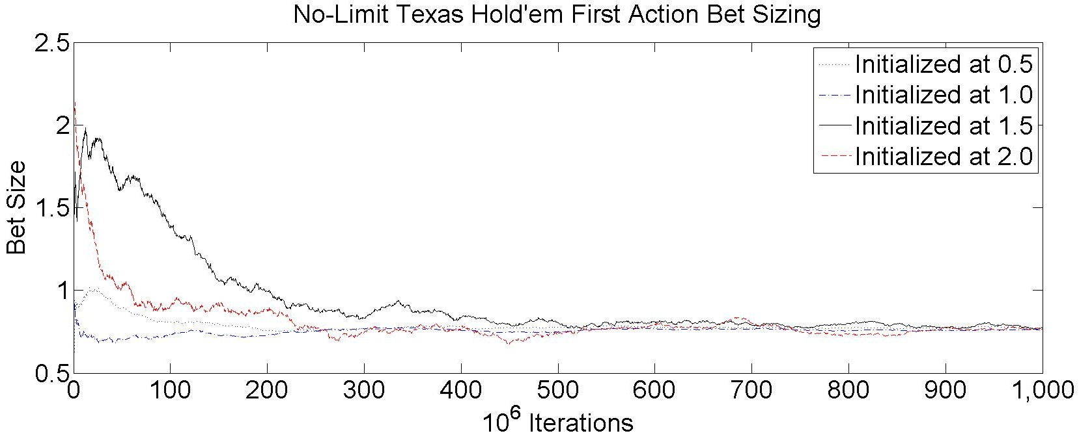
Notes:
Optimal first action bet size is 0.77x pot.

Slide 81
Original game
Abstracted game
Automated abstraction
Custom
equilibrium-finding
algorithm
Nash equilibrium
Reverse model
Nash equilibrium

Slide 82

Picture credit: Pittsburgh Supercomputing Center
Notes:
(More poker in 3 months than mankind.)

Slide 83

Bridges supercomputer at the Pittsburgh Supercomputing Center

Slide 84
Scalability of (near-)equilibrium finding in 2-player 0-sum games
AAAI poker competition announced
Gilpin, Sandholm
& Sørensen
Scalable EGT
Zinkevich et al.
Counterfactual regret
Gilpin, Hoda,
Peña & Sandholm
Scalable EGT
Koller & Pfeffer
Using sequence form
& LP (simplex)
Billings et al.
LP (CPLEX interior point method)
Gilpin & Sandholm
LP (CPLEX interior point method)

Slide 85
Scalability of (near-)equilibrium finding in 2-player 0-sum games…
Regret-based pruning [Brown & Sandholm NIPS-15]
Information sets
Cepheus [Bowling et al.]
Tartanian7 [Brown, Ganzfried & Sandholm]
5.5 * 10¹⁵ nodes
Slumbot [Jackson]
Hyperborean [Bowling et al.]
Hyperborean [Bowling et al.]
Hyperborean [Bowling et al.]
Hyperborean [Bowling et al.]
GS3 [Gilpin, Sandholm & Sørensen]
Losslessly abstracted
Rhode Island Hold’em
[Gilpin & Sandholm]

Slide 86
Leading equilibrium-finding algorithms for 2-player 0-sum games
Counterfactual regret (CFR)
Scalable EGT
Based on no-regret learning
Most powerful innovations:
  Each information set has a separate no-regret learner [Zinkevich et al. NIPS-07]
  Sampling
  [Lanctot et al. NIPS-09, …]
O(1/ε²) iterations
  Each iteration is fast
Parallelizes
Selective superiority
Can be run on imperfect-recall games and with >2 players (without guarantee of converging to equilibrium)
Based on Nesterov’s Excessive Gap Technique
Most powerful innovations:
[Hoda, Gilpin, Peña & Sandholm WINE-07, Mathematics of Operations Research 2011]
  Smoothing fns for sequential games
  Aggressive decrease of smoothing
  Balanced smoothing
  Available actions don’t depend on chance => memory scalability
O(1/ε) iterations
  Each iteration is slow
Parallelizes
New O(log(1/ε)) algorithm [Gilpin, Peña & Sandholm AAAI-08, Math. Programming 2012]
First-order methods that are based on tree traversals and support sampling [Kroer, Waugh, Kılınç-Karzan & Sandholm EC-15]

Slide 87
Better first-order methods
[Kroer, Waugh, Kılınç-Karzan & Sandholm EC-15]
New prox function for first-order methods such as EGT and Mirror Prox
  Gives first explicit convergence-rate bounds for general zero-sum extensive-form games (prior explicit bounds were for very restricted class)
  In addition to generalizing, bound improvement leads to a linear (in the worst case, quadratic for most games) improvement in the dependence on game specific constants
Introduces gradient sampling scheme
  Enables the first stochastic first-order approach with convergence guarantees for extensive-form games
  As in CFR, can now represent game as tree that can be sampled
Introduces first first-order method for imperfect-recall abstractions
  As with other imperfect-recall approaches, not guaranteed to converge

Slide 88
Purification and thresholding
Thresholding: Rounding the probabilities to 0 of those actions whose probabilities are less than c
(and rescaling the other probabilities)
  Purification is thresholding with c = ½
Proposition. Can help or hurt arbitrarily much, when played against equilibrium strategy in unabstracted game
[Ganzfried, Sandholm & Waugh AAMAS-12]

Slide 89
Experiments on purification & thresholding
No-limit Texas Hold’em: Purification beats threshold 0.15, does better than it against all but one 2010 competitor, and won bankroll competition
Limit Texas Hold’em:
Threshold too high
=> not enough randomization
=> signal too much
Threshold too low
=> strategy overfit to abstraction
Less randomization
Notes:
2-player zero-sum 4x4 matrix games (random abstractions): Helps

Slide 90
Endgame solving
Strategies for entire game computed offline in a coarse abstraction
Endgame strategies computed in real time in finer abstraction
[Gilpin & Sandholm AAAI-06, Ganzfried & Sandholm IJCAI-13 WS, AAMAS-15]
Notes:
It is a design choice as to where the endgame starts.
The beliefs at the beginning of the endgame are inferred using Bayes’ rule from the equilibrium for the earlier part of the game and the actions taken there.

Slide 91
Benefits of endgame solving
Finer-grained information and action abstraction (helps in practice)
  Dynamically selecting coarseness of action abstraction
New information abstraction algorithms that take into account relevant distribution of players’ types entering the endgames
Computing exact (rather than approximate) equilibrium strategies
Computing equilibrium refinements
Solving the “off-tree” problem
…

Slide 92



Limitation of endgame solving
0,0
-1,1
1,-1
1,-1
0,0
-1,1
-1,1
1,-1
0,0
Notes:
(Proposition: There exist games with a unique equilibrium and a single endgame for which endgame solving can produce a non-equilibrium strategy profile in the full game.)

Slide 93
Experiments on No-limit Texas Hold’em
Solved last betting round in real time using CPLEX LP solver
  Abstraction dynamically chosen so the solve averages 10 seconds
[Ganzfried & Sandholm IJCAI-13 WS]

Slide 94
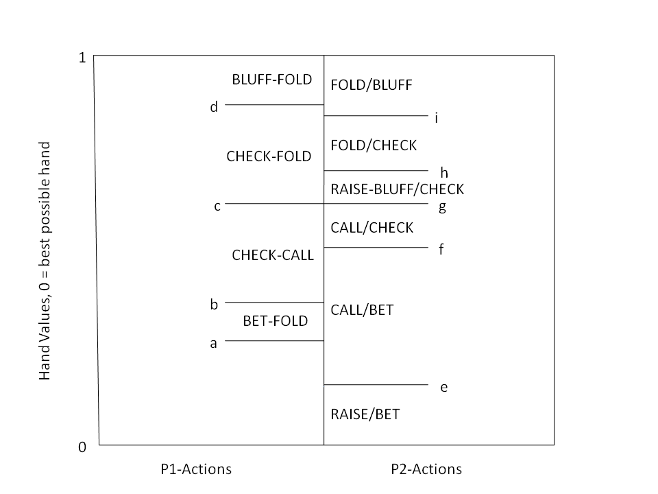
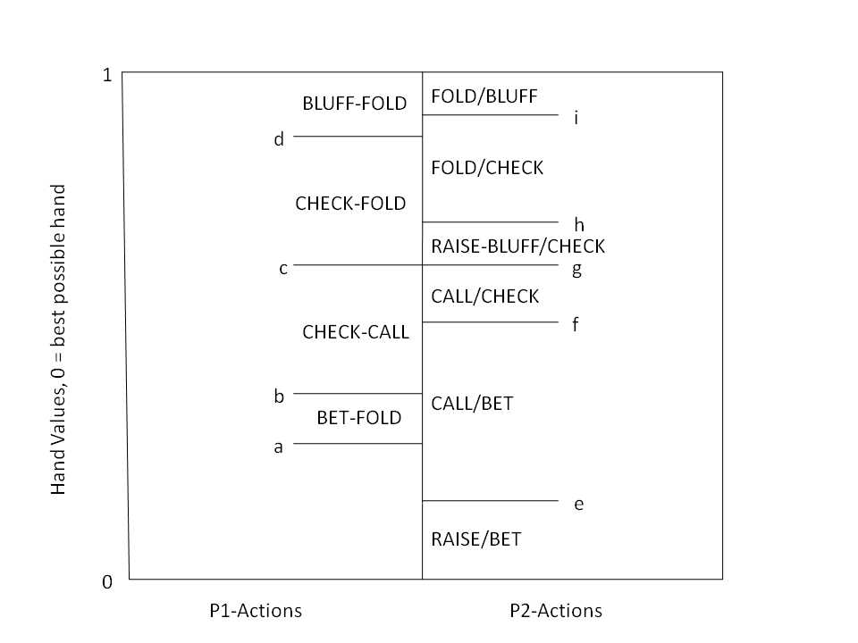
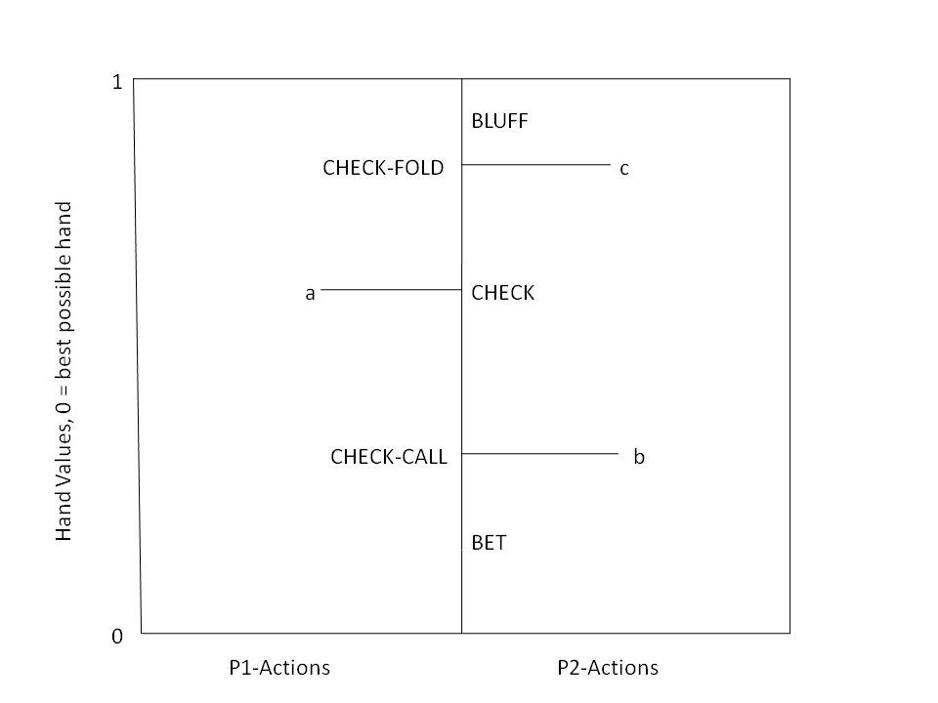
Computing equilibria by leveraging qualitative models
Player 1’s
strategy
Player 2’s
strategy
Weaker
hand
BLUFF/CHECK
BLUFF/CHECK
Stronger
hand
Theorem. Given F₁, F₂, and a qualitative model, we have a complete mixed-integer linear feasibility program for finding an equilibrium
Qualitative models can enable proving existence of equilibrium & solve games for which algorithms didn’t exist
[Ganzfried & Sandholm AAMAS-10 & newer draft]
Notes:
Limit.
River with 1 raise allowed.
It is ok if the models are wrong!
(Sam iterated to come up with these 3 models. He got the first one from Chen & Ankeman book.)
Which of these 3 models is right depends on the private signal distributions at the beginning of the endgame (fourth round).
Experiments found an eq with one of these for each F1, F2 reached in practice. Sam says there is a 4th one, that was never reached between these players.
Use qualitative models to learn about poker by testing different ones (manually or automatically generated).
(Analogy to air combat)

Slide 95
Original game
Abstracted game
Automated abstraction
Custom
equilibrium-finding
algorithm
Nash equilibrium
Reverse model
Nash equilibrium

Slide 96
Action translation
x
“Pseudo-harmonic mapping”
f(x) = [(B-x)(1+A)] / [(B-A)(1+x)]
Derived from Nash equilibrium of a simplified no-limit poker game
Satisfies the desiderata
Much less exploitable than prior mappings in simplified domains
Performs well in practice in no-limit Texas Hold’em
  Significantly outperforms randomized geometric
A
B
$
f(x) ≡ probability we map x to A
Desiderata about f
  f(A) = 1, f(B) = 0
  Monotonicity
  Scale invariance
  Small change in x doesn’t lead to large change in f
  Small change in A or B doesn’t lead to large change in f
[Ganzfried & Sandholm IJCAI-13]
Notes:
Arithmetic -> geometric
Randomized
We showed all these lead to high exploitability in small poker games.
Randomized geometric fails the last desideratum.
(Clairvoyance game, Kuhn poker, Leduc Hold’em)

Slide 97
Simultaneous Abstraction and Equilibrium Finding in Games
[Brown & Sandholm IJCAI-15 & new manuscript]

Slide 98
Action Abstraction
P1
P2
. . .
. . .
P2
. . .
. . .
P2

Slide 99
Action Abstraction
P1
P2
P2
P2
[e.g., Gilpin, A., Sandholm, T. & Sørensen, T. AAMAS-08, …]

Slide 100
Reverse Mapping
P1
P2
P2
P2
[Gilpin, A., Sandholm, T. & Sørensen, T. AAMAS-08]
[Schnizlein et al. IJCAI-09]
[Ganzfried & Sandholm IJCAI-13]

Slide 101
Reverse Mapping
P1
P2
P2
P2
P2
[Gilpin et al. AAMAS-08]
[Schnizlein et al. IJCAI-09]
[Ganzfried & Sandholm IJCAI-13]

Slide 102
Recall: Standard Approach
[Gilpin & Sandholm EC-06, J. of the ACM 2007…]
Original game
Abstracted game
Automated abstraction
Custom
equilibrium-finding
algorithm
Nash equilibrium
Reverse model
Nash equilibrium
Foreshadowed by Shi & Littman 01, Billings et al. IJCAI-03
Notes:
MENTION AS OUTLINE:
- Opponent exploitation
- Bots vs pros
- Learning from bots
(Reverse model is straightforward if only signals are abstracted, but an interesting problem if also actions are abstracted, as in No-Limit Texas Hold’em.)

Slide 103
Problems
Need to abstract to solve the game, but also need the solution to optimally abstract
If the abstraction changes, equilibrium finding must restart
  Except in special cases [Brown & Sandholm AAAI-14]
Abstraction size must be tuned to the available run time
Finer abstractions not always better [Waugh et al. AAMAS-09]
Cannot feasibly calculate exploitability in the full game
Notes:
Possible subbullets for first bullet:
Human domain knowledge is used to get around this
Or, can solve a small abstraction and use its solution to build a larger abstraction

Slide 104
Simultaneous Approach
[Brown & Sandholm IJCAI-15]
Original game
Abstracted game
Automated abstraction
Custom
equilibrium-finding
algorithm
Nash equilibrium
Reverse model
Nash equilibrium
Notes:
MENTION AS OUTLINE:
- Opponent exploitation
- Bots vs pros
- Learning from bots
(Reverse model is straightforward if only signals are abstracted, but an interesting problem if also actions are abstracted, as in No-Limit Texas Hold’em.)

Slide 105
Simultaneous Approach
[Brown & Sandholm IJCAI-15]
Original game
Simultaneous abstraction and
equilibrium finding (SAEF)
Nash equilibrium
Notes:
MENTION AS OUTLINE:
- Opponent exploitation
- Bots vs pros
- Learning from bots
(Reverse model is straightforward if only signals are abstracted, but an interesting problem if also actions are abstracted, as in No-Limit Texas Hold’em.)

Slide 106

Regret Matching
Start with a uniform random strategy $p^{1}\left(a\right)= \frac{1}{|A|}$
Each action $a$ results in a payoff $u^{t}\left(a\right)$
Receive a reward $v^{t}=\sum_{a}{p^{t}\left(a\right)u^{t}\left(a\right)}$
Regret for action $a$ is $R^{t}\left(a\right)= \sum_{t}{(u^{t}\left(a\right)−v^{t})}$
Next probability of action $a$ is $p^{t+1}\left(a\right)=\frac{max\left\{0, R^{t}\left(a\right)\right\}}{\sum_{a^{′}}{max\left\{0, R^{t}\left(a^{′}\right)\right\}}}$
Regret bound [Cesa-Bianchi and Lugosi 2006]: $R^{T}\left(a\right)∈O(\sqrt{T})$
So, as $T →∞,\frac{\max_{a}{R^{T}\left(a\right)}}{T}→0$
Folk Theorem [e.g. Waugh 2009]: In a two-player zero-sum game, if
both players’ average regrets are bounded by ε, then their average strategies
form a 2ε-Nash equilibrium.
SAEF minimizes regret in all games; converges to a Nash equilibrium in two-player zero-sum games

Slide 107


Counterfactual Regret Minimization (CFR)
[Zinkevich et al. NIPS-07]
CFR runs regret matching separately for each information set
$π^{t}\left(h,z\right)$ is the probability that terminal node $z$ is reached from $h$ on iteration $t$
$π_{−i}^{t}(h)$ is the probability state $h$ is reached, if player $i$ tries to reach it
$u_{i}^{t}\left(I\right)=\sum_{h∈I,z∈Z}{π_{−i}^{t}\left(h\right)π^{t}\left(h,z\right)u_{i}(z)}$ is the reward for infoset $I$, weighted by $π_{−i}^{t}$
$R_{i}^{t}\left(I,a\right)=\sum_{t}{\left(u_{i}^{t}\left(I→a\right)−u_{i}^{t}\left(I\right)\right)}$ is regret for action $a$ in infoset $I$
Theorem: regret for the whole game is bounded by regret summed over all infosets. $R_{i}^{t}≤\sum_{I}{R_{i}^{t}(I)}$
0.5
P1
P2
0.2
P1
$$π_{−i}^{t}=0.5⋅0.2$$
P2
P2
Notes:
$I→a$ means the player always chooses action $a$ in infoset $I$

Slide 108
New Results

Slide 109

Adding Actions to an Abstraction
Want to add an action on iteration $T$ of CFR
P1
P2
P2
P2

Slide 110
Adding Actions to an Abstraction
Want to add an action on iteration $T$ of CFR
Key idea: assume the action was always present, but was never played
Two challenges:
  What happened in that branch on iterations $1$ through $T$?
  This may violate CFR, so regret may exceed its bound
P1
P2
P2
P2

Slide 111
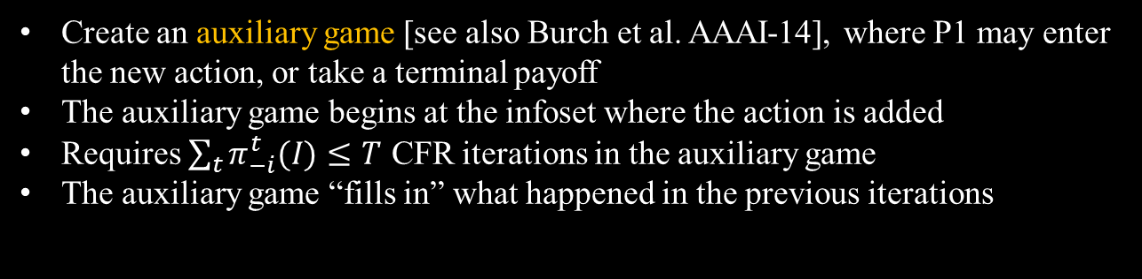
Filling in Iterations
P1
P1
P2
P2
P2
$$\frac{1}{T}\sum_{t}{u^{t}(I)}$$
P2
Copy strategy
Create an auxiliary game [see also Burch et al. AAAI-14], where P1 may enter
the new action, or take a terminal payoff
The auxiliary game begins at the infoset where the action is added
Requires $\sum_{t}{π_{−i}^{t}(I)}≤T$ CFR iterations in the auxiliary game
The auxiliary game “fills in” what happened in the previous iterations
Notes:
Similar approach used in Burch et al AAAI-14 and Jackson AAAI-14 . However, those were only used to reconstruct a strategy for an existing action after equilibrium finding finished (for example, to compress the storage of the strategy).

Slide 112
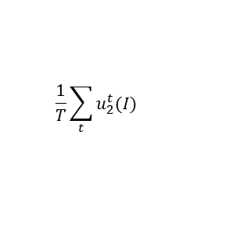
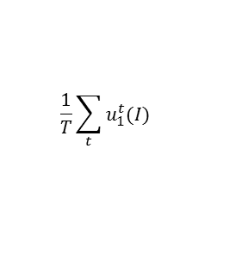

Filling in Iterations
P1
P1
P2
P2
P2
P2
In imperfect information games,
an action may originate from
multiple infosets
Add a chance node to the
auxiliary game that reaches
each originating history
according to the probability
it was reached in the $T$ iterations
C
P1
P1
P2
P2
$$\frac{1}{T}\sum_{t}{u_{1}^{t}(I)}$$
$$\frac{1}{T}\sum_{t}{u_{2}^{t}(I)}$$

Slide 113



Alternative to Auxiliary Game: Regret Transfer
Special case:
  Payoffs are function of $θ$
  Action chooses $θ$
  Identical structure to another subgame
P1
$$θ_{1}$$
$$θ_{2}$$
P2
P2
Notes:
Regret Transfer is an alternative to the Auxiliary Game, but can only be used in special cases.

Slide 114

Alternative to Auxiliary Game: Regret Transfer
Special case:
  Payoffs are function of $θ$
  Action chooses $θ$
  Identical structure to another subgame
Store regret as function of $θ$
When adding new action $θ_{2}$, copy over regret function and replace $θ_{1}$ with $θ_{2}$
Takes O(1) time, compared to Auxiliary Game which takes O($T$)
P1
$$θ_{1}$$
$$θ_{2}$$
P2
P2

Slide 115

Regret Discounting
(applies to both auxiliary game and regret transfer)
Second Problem: If the new action was never played, we may have violated CFR. Thus, the regret bounds don’t hold.
Theorem: Suppose player $i$ played $T$ iterations in a game with $\text{I}$ information sets and where $Δ$ is the maximum payoff. Choose any weight $w_{i}$ such that
$$0≤w_{i}≤min\left\{1,\frac{\left|\text{I}\right|\left|A\right|Δ^{2}T}{\sum_{I,a}{{\left(R_{+}^{T}\left(I,a\right)\right)}^{2}}}\right\}$$
If we weigh the first $T$ iterations by $w_{i}$ and then play according to regret matching, regret will remain below the CFR bound.
Good choice of $w_{i}$ in practice: $\frac{\sum_{I,a}{{\left(R_{+}^{′T}\left(I,a\right)\right)}^{2}}}{\sum_{I,a}{{\left(R_{+}^{T}\left(I,a\right)\right)}^{2}}}$ where $R^{′}$ represents regret before the action was added.
Notes:
Choosing the maximum $w_i$ is not necessarily best in practice. The “better choice” satisfies the theorem, and does better in practice than the maximum possible $w_i$.
We had a weaker theorem in Brown & Sandholm AAAI-14.

Slide 116
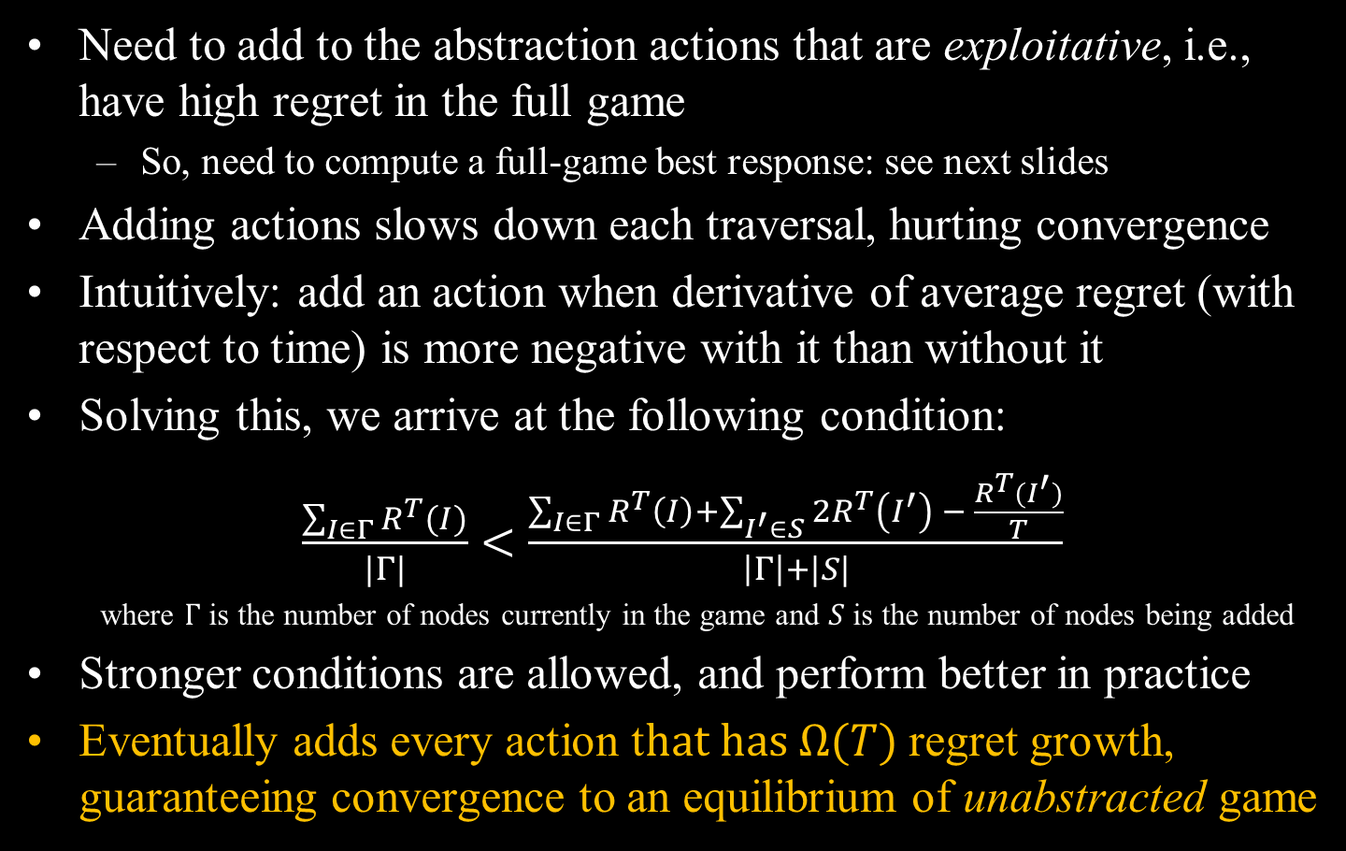
Where and When to Add Actions?
Need to add to the abstraction actions that are exploitative, i.e., have high regret in the full game
  So, need to compute a full-game best response: see next slides
Adding actions slows down each traversal, hurting convergence
Intuitively: add an action when derivative of average regret (with respect to time) is more negative with it than without it
Solving this, we arrive at the following condition:
$\frac{\sum_{I∈Γ}{R^{T}(I)}}{|Γ|}<\frac{\sum_{I∈Γ}{R^{T}\left(I\right)}+\sum_{I^{′}∈S}{2R^{T}\left(I^{′}\right) − \frac{R^{T}(I^{′})}{T}}}{\left|Γ\right|+|S|}$
where $Γ$ is the number of nodes currently in the game and $S$ is the number of nodes being added
Stronger conditions are allowed, and perform better in practice
Eventually adds every action t$hat has Ω(T)$ regret growth, guaranteeing convergence to an equilibrium of unabstracted game
Notes:
We use “nodes touched” as a proxy for time. Once an action is in the abstraction, its regret grows in $O(\sqrt{T})$. Therefore, any action with $Ω(T)$ regret growth will eventually have regret grow faster than any finite number of $O(\sqrt{T})$ infosets. Thus, we will eventually add that action to the abstraction. (We actually add all actions whose regret grows faster than ~$\sqrt{T}$.

Slide 117







Calculating Full-Game Best Response
$$50$$
P1
A best response is typically calculated by traversing the game tree
$$40$$
$$50$$
P2
P2
$$p$$
$$1−p$$
$$q$$
$$1−q$$

Slide 118
Calculating Full-Game Best Response
P1
A best response is typically calculated by traversing the game tree
This is infeasible for large or infinite games
. . .
P2
P2

Slide 119



Calculating Full-Game Best Response
P1
But action translation defines strategy for a range of actions
Special case: Action chooses $θ$ and all payoffs following next action are multiples of $θ$
All future payoffs are scaled by $θ$, so states are strategically identical regardless of $θ$
Pass down variable $θ$
. . .
$$f_{1}\left(θ\right)$$
$$f_{2}\left(θ\right)$$
P2
P2

Slide 120



Calculating Full-Game Best Response
P1
But action translation defines strategy for a range of actions
Special case: Action chooses $θ$ and all payoffs following next action are multiples of $θ$
All future payoffs are scaled by $θ$, so states are strategically identical regardless of $θ$
Pass down variable $θ$
Wait until payoff $f\left(θ\right)$ is passed up and choose $\underset{θ}{argmax}{f(θ)}$
$$\underset{θ}{argmax}{f_{1}(θ)}$$
$$\underset{θ}{argmax}{f_{2}(θ)}$$
. . .
$$f_{1}\left(θ\right)$$
$$f_{2}\left(θ\right)$$
P2
P2

Slide 121

Removing Actions
Some actions may be added early, but turn out to be useless
Pruning: actions that are “bad” need not always be explored
Theorem. In a two-player zero-sum game, if an action $a$ is not part of a best response to a Nash equilibrium strategy, then $R^{T}\left(I,a\right)→−∞$ and action $a$ need only be explored on the first $O\left(1\right)$ iterations.
  Furthermore, some of these iterations are skippable (if regret couldn’t turn positive)
Notes:
Theorem says we asymptotically prune almost all actions that are played with zero probability. However, there are some actions that are part of a best response, but not part of any Nash equilibrium support. These are not pruned.
We don’t know how to calculate the O(1) constant before we reach that time.

Slide 122
Experiments
Tested on Continuous Leduc Hold’em
  Payoffs are multiplied by prior actions
Initial abstraction contains just minimum and maximum possible actions
Tested against abstractions with 2, 3, and 5 bet sizes in each information set spaced according to pseudoharmonic mapping [Ganzfried & Sandholm IJCAI-13]

Slide 123
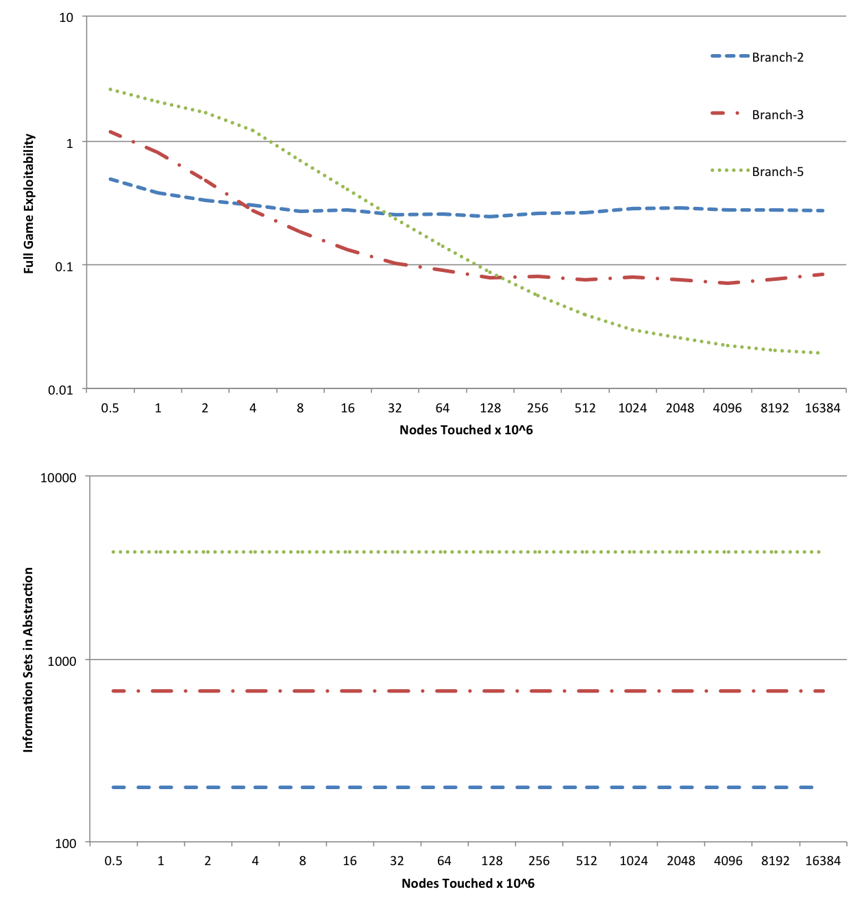
Experiments
Branch-2: Two bet sizes
Branch-3: Three bet sizes
Branch-5: Five bet sizes

Slide 124
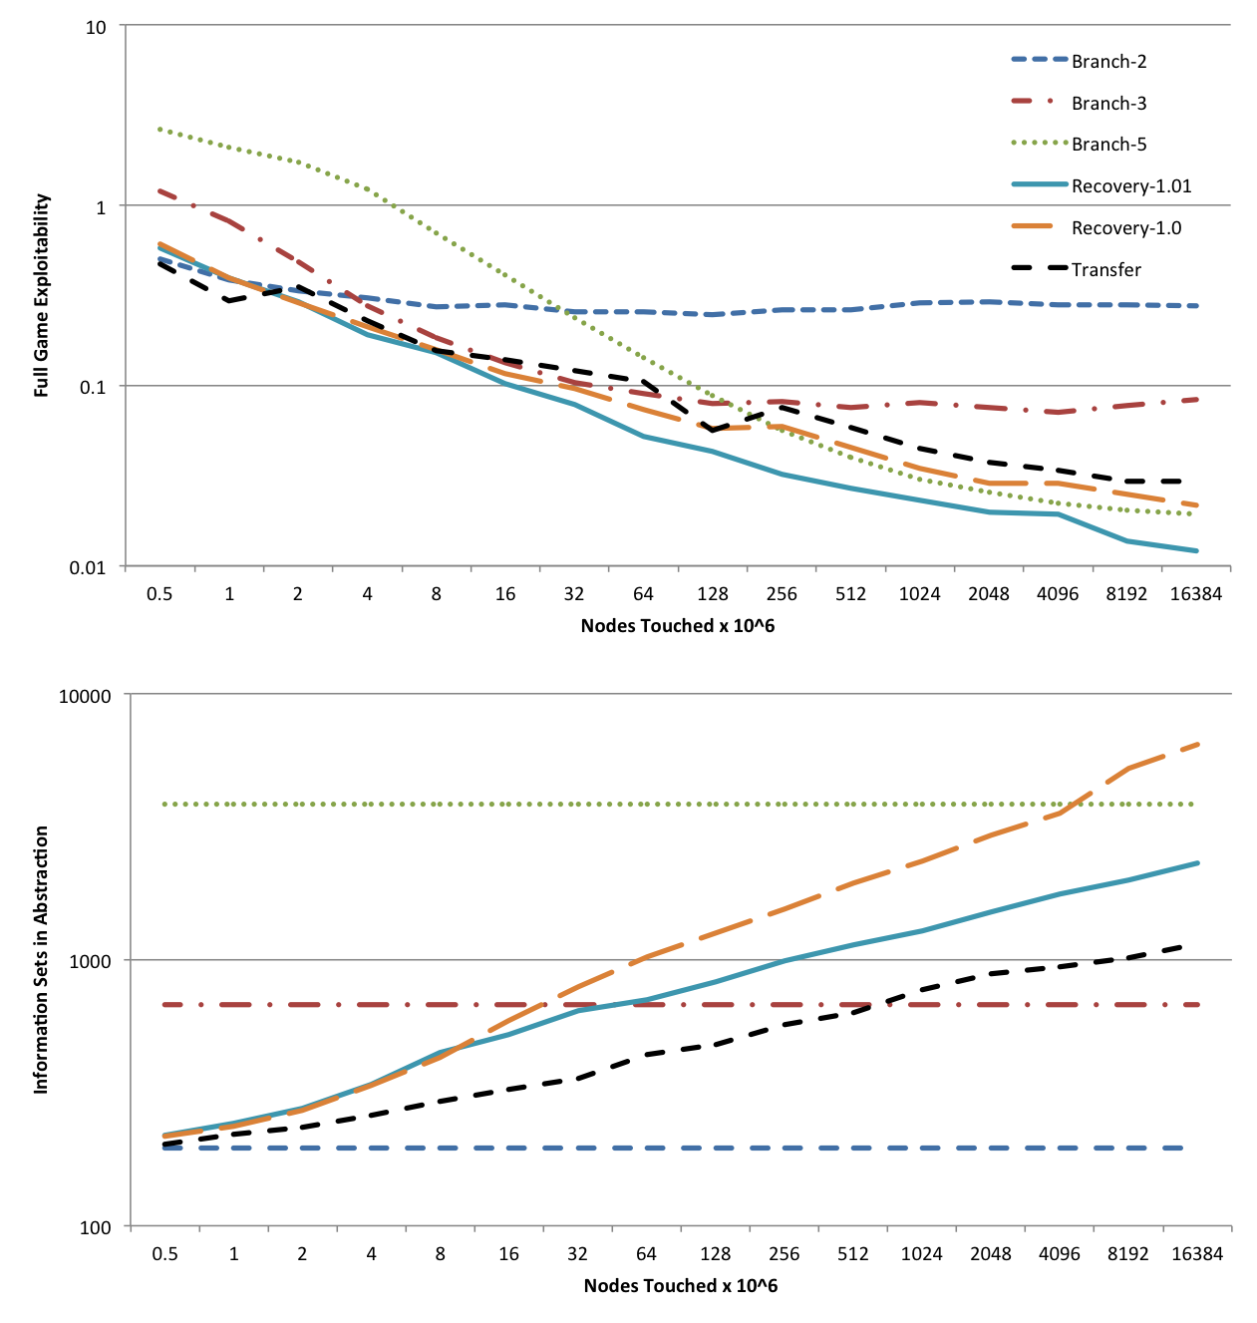
Experiments
Branch-2: Two bet sizes
Branch-3: Three bet sizes
Branch-5: Five bet sizes
Recovery-1.0: Uses theoretical condition for adding an action
Recovery-1.01: Tightens condition for adding an action by a factor of 1.01
Transfer: Uses regret transfer instead of auxiliary game
All the SAEF variants go to 0, Branch-5 levels off

Slide 125
Problems Solved
Cannot solve without abstracting, and cannot principally abstract without solving
  SAEF abstracts and solves simultaneously
Must restart equilibrium finding when abstraction changes
  SAEF does not need to restart (uses discounting)
Abstraction size must be tuned to available runtime
  In SAEF, abstraction increases in size over time
Larger abstractions may not lead to better strategies
  SAEF guarantees convergence to a full-game equilibrium
Cannot calculate a full-game best response in large games
  In special cases, possible in the size of the abstraction

Slide 126
Problems solved
Cannot solve without abstracting, and cannot principally abstract without solving
  SAEF abstracts and solves simultaneously
Must restart equilibrium finding when abstraction changes
  SAEF does not need to restart (uses discounting)
Abstraction size must be tuned to available runtime
  In SAEF, abstraction increases in size over time
Larger abstractions may not lead to better strategies
  SAEF guarantees convergence to a full-game equilibrium
Notes:
Cannot calculate a full-game best response in large games
In special cases, possible in the size of the abstraction

Slide 127
State of TOP poker programs

Slide 128
Rhode Island Hold’em
Bots play optimally
[Gilpin & Sandholm EC-06, J. of the ACM 2007]

Slide 129
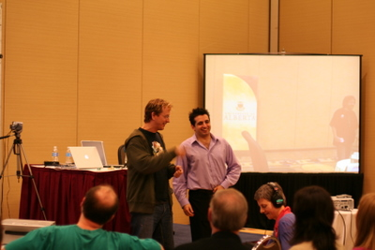
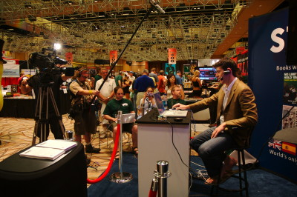
Heads-Up Limit Texas Hold’em
Bots surpassed pros in 2008
[U. Alberta Poker Research Group]
“Essentially solved” in 2015 [Bowling et al.]
AAAI-07
2008
Notes:
On 6/25/2013 in a live stream, Phil Galfond said he thought that hyperborean could beat mid-stakes online (1-2 and 2-4), but not higher currently. But he thinks within several years it will beat top humans.
(2008: They had 5 strong human opponents: Grudzien, Hawrilenko, Palansky, Paradis, and Hendon. The player in the picture is Matt “Hoss_TBF” Hawrilenko, the strongest heads-up limit player at the time according to Michael Bowling.)

Slide 130

Heads-Up No-Limit Texas Hold’em
Annual Computer Poker Competition
Tartanian7
--> Claudico
Statistical significance win against every bot
Smallest margin in IRO: 19.76 ± 15.78
Average in Bankroll: 342.49
(next highest: 308.92)

Slide 131
Strategy refinement
[See also Jackson 2014]
Calculate the EV for P1 for limping in Tartanian7.
In Claudico (P2), replace game tree following limp with a terminal EV payoff.
This converges to a NE strategy if the limp EV’s are “correct.”
Reduces the game tree size by ~75%, allowing 90,000 buckets after the flop.
If opponent is P1 and limps, revert to Tartanian7 (hardly ever happened).
Tartanian7
P1
Limp
Claudico (P2)
P1
Limp
EV
Notes:
It's basically the same thing Eric Jackson describes in his workshop paper (and which I independently came up with). We calculated the EV that the SB gets for limping with each hand on the button in the Tartanian7 strategies (which, if limping is in the support, is the same EV the SB should get for taking any other action in the support). We then constructed a game with 90,000 buckets where limping is a legal option for the button player, but where limping results in an immediate payoff of the previously-calculated EV.
This allows us to avoid having a limping branch in the game tree (which is ~75% of the total size of the game). When playing against the humans, if they ever limp then we play the Tartanian7 strategy from that point on. This does *not* converge to a Nash equilibrium strategy for the SB player. However, if the EV's are "correct" (that is, they are the actual EV's that the SB would get in a NE), then it does lead to a NE strategy for the BB player (which is the player whose strategy we used).
Refinement could also be used later in the game, but one has to be careful as follows. If one action (preceded by a given action sequence, of course), turns out worse than previously thought, that player has to be allowed to take his fixed EV of *any action at any earlier point in that sequence*.

Slide 132
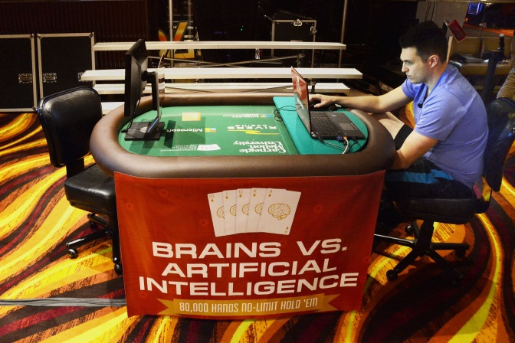
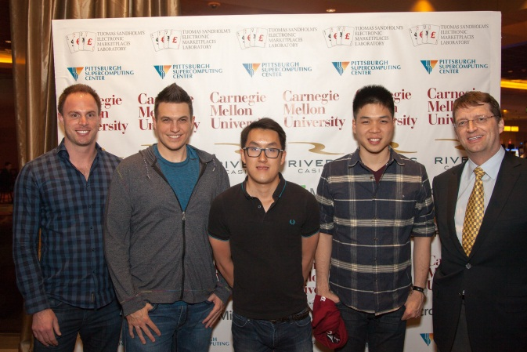

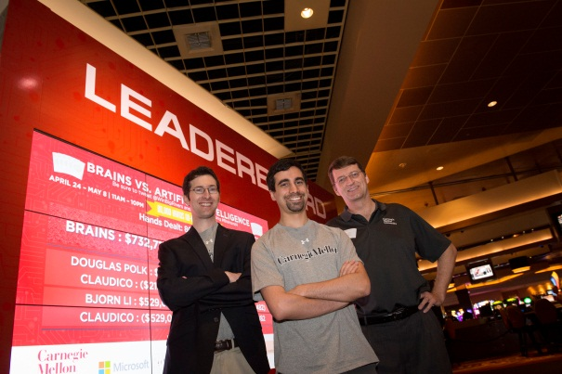
Heads-Up No-Limit Texas Hold’em
Claudico
Annual Computer Poker Competition
Tartanian7

Slide 133
“Brains vs AI” event

Slide 134

Claudico against each of 4 of the top-10 pros in this game
4 * 20,000 hands over 2 weeks
Strategy was precomputed, but we used endgame solving [Ganzfried & Sandholm AAMAS-15] in some sessions

Slide 135


Slide 136
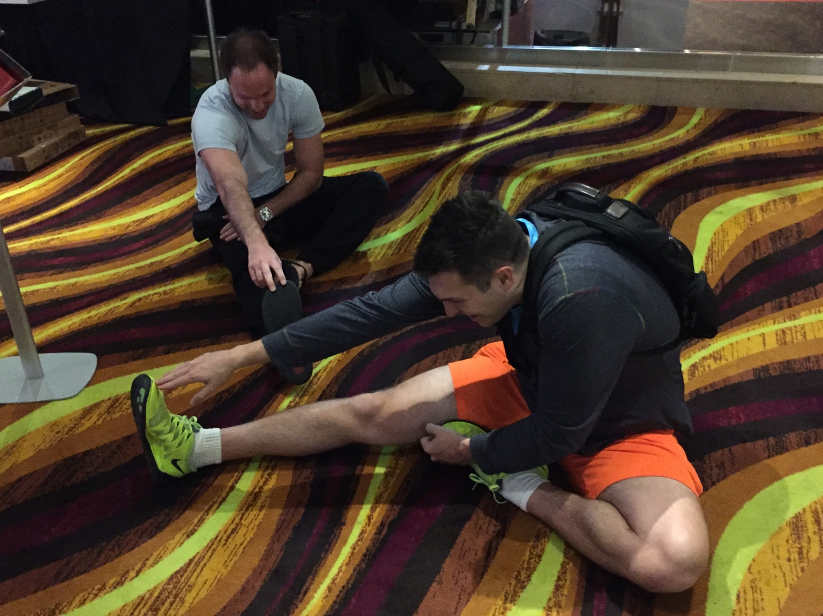
Humans’ $100,000 participation fee distributed based on performance

Slide 137
Overall performance
Pros won by 91 mbb/hand
  Not statistically significant (at 95% confidence)
  Perspective:
    Dong Kim won a challenge against Nick Frame by 139 mbb/hand
    Doug Polk won a challenge against Ben Sulsky 247 mbb/hand
3 pros beat Claudico, one lost to it
Pro team won 9 days, Claudico won 4

Slide 138
Observations about Claudico’s play
Strengths (beyond what pros typically do):
  Small bets & huge all-ins
  Perfect balance
  Randomization: not “range-based”
  “Limping” & “donk betting” …
Weaknesses:
  Coarse handling of “card removal” in endgame solver
    Because endgame solver only had 20 seconds
  Action mapping approach
  No opponent exploitation

Slide 139
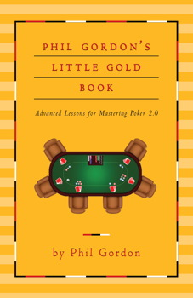
First action:
To fold, “limp”, or raise (the typical 1×pot)?
"Limping is for Losers
This is the most important fundamental in poker--for every game, for every tournament, every stake: If you are the first player to voluntarily commit chips to the pot, open for a raise. Limping is inevitably a losing play. If you see a person at the table limping, you can be fairly sure he is a bad player. Bottom line: If your hand is worth playing, it is worth raising."
Daniel Cates: “we're going to play 100% of our hands...We will raise ...
We will be making small adjustments to that strategy depending on how our opponent plays ... Against the most aggressive players … it is acceptable to fold the very worst hands …, around the bottom 20% of hands. It is probably still more profitable to play 100% ..."
Our bots limp! Claudico is latin for “I limp”.

Slide 140
“Donk bet”
A common sequence in 1st betting round:
  First mover raises, then second mover calls
  The latter has to move first in the second betting round. If he bets, that is a “donk bet”
Considered a poor move
Our bots donk bet!

Slide 141
1 or more bet sizes (for a given betting sequence and public cards)?
Using more than 1 risks signaling too much
Most pros use 1 (some sometimes use 2)
  Typical bet size is 1×pot in the first betting round, and between ⅔×pot and ¾×pot in later rounds
Our bots sometimes randomize between many sizes (even with a given hand)
  “Perfectly balanced” (bluff hands and “value hands”)
  Includes unusually small and large bets (all-in 37×pot)

Slide 142
Multiplayer poker
Bots aren’t very strong (yet)
Exceptions:
  Near-optimal strategies have been computed for jam/fold tournaments [Ganzfried & Sandholm AAMAS-08, IJCAI-09]
  A family of equilibria of 3-player Kuhn poker has been derived analytically [Szafron et al. AAMAS-13]

Slide 143
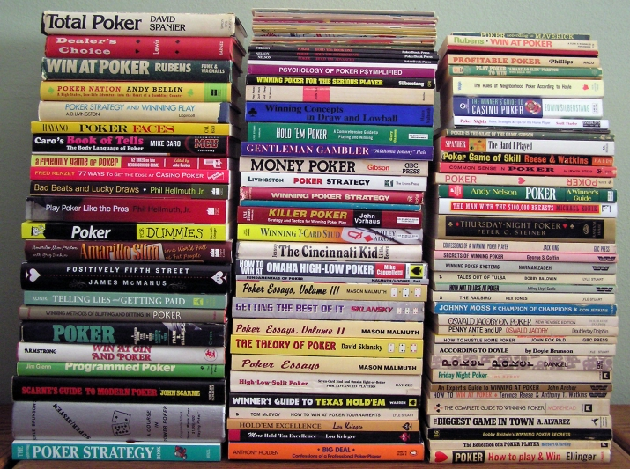

Learning from bots
0.03647, 0.39408, 0.0,
0.43827, 0.0, 0.0, 0.04147,
…
Ground truth
Picture from Ed Collins’s web page
Notes:
Humans can learn from the bots.
More poker in 3 months than mankind.
(What I present below is for stacks of 200 big blinds, i.e., the No-Limit Texas Hold’em game in the Annual Computer Poker Competition.)

Slide 144
Conclusions
Domain-independent techniques
Automated lossless information abstraction: exactly solved 3-billion-node game
Lossy information abstraction is key to tackling large games like Texas Hold’em. Main progress 2007-2013: integer programming, potential-aware, imperfect recall
Presented some of our new results from 2014:
  First information abstraction algorithm that combines potential aware and imperfect recall
  First lossy extensive-form game abstraction with bounds: framework, algorithms, complexity, impossibility level-by-level, better lossless abstraction
  First action abstraction algorithm with optimality guarantees: iterative action size vector changing
Future research
  Better algorithms within our lossy abstraction with bounds framework
  Applying these techniques to other domains

Slide 145
Conclusions
Domain-independent techniques
Abstraction
  Automated lossless abstraction—exactly solves games with billions of nodes
  Best practical lossy abstraction: potential-aware, imperfect recall, EMD
  Lossy abstraction with bounds
    For action and state abstraction
    Also for modeling
  Simultaneous abstraction and equilibrium finding [Brown & S. IJCAI-15]
  Pseudoharmonic reverse mapping [Ganzfried & S. IJCAI-13]
  Endgame solving [Ganzfried & S. AAMAS-15]
Equilibrium-finding
  Can solve 2-person 0-sum games with 10¹⁴ information sets to small ε
    O(1/ε²) -> O(1/ε) -> O(log(1/ε))
  New framework for fast gradient-based algorithms [Kroer et al. EC-15]
    Works with gradient sampling and can be run on imperfect-recall abstractions
  Regret-based pruning for CFR [Brown & S. NIPS-15]
  Using qualitative knowledge/guesswork [Ganzfried & S. AAMAS-10 & newer draft]

Slide 146
Topics I didn’t cover
[joint work mainly with Sam Ganzfried]
Purification and thresholding help
Endgame solving helps
Leveraging qualitative models => existence, computability, speed, insight
Scalable practical online opponent exploitation algorithm
Fully characterized safe exploitation & provided algorithms
New poker knowledge

Slide 147
Current & future research
Lossy abstraction with bounds
  Scalable algorithms
  With structure
  With generated abstract states and actions
Equilibrium-finding algorithms for 2-person 0-sum games
  Even better gradient-based algorithms
  Parallel implementations of our O(log(1/ε)) algorithm and better understanding how #iterations depends on matrix condition number
  Making interior-point methods usable in terms of memory
  Additional improvements to CFR
Endgame and “midgame” solving with guarantees
Equilibrium-finding algorithms for >2 players
Theory of thresholding, purification [Ganzfried, S. & Waugh AAMAS-12], and other strategy restrictions
Other solution concepts: sequential equilibrium, coalitional deviations, …
Application to other games (medicine, cybersecurity, etc.)
Opponent exploitation & understanding exploration vs exploitation vs safety
Notes:
(Ex ante & ex post)

